Slide 1


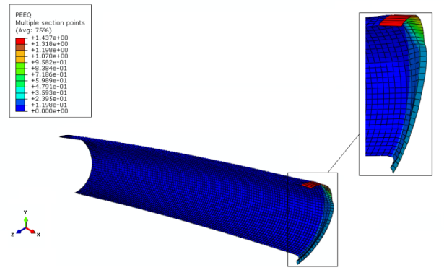
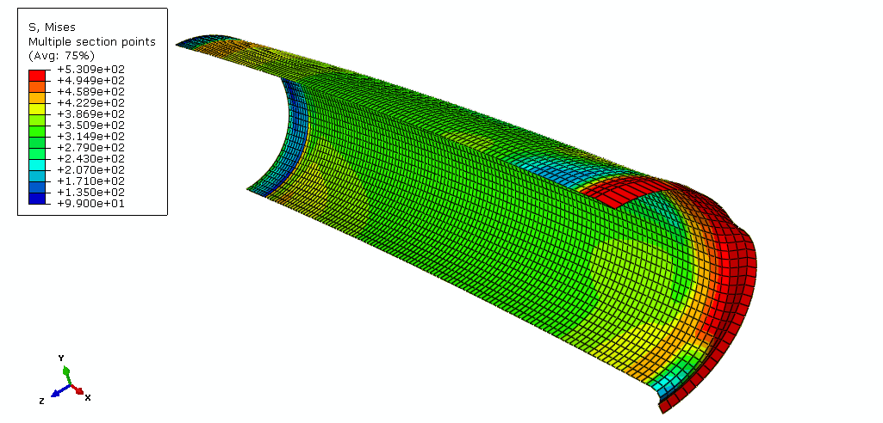
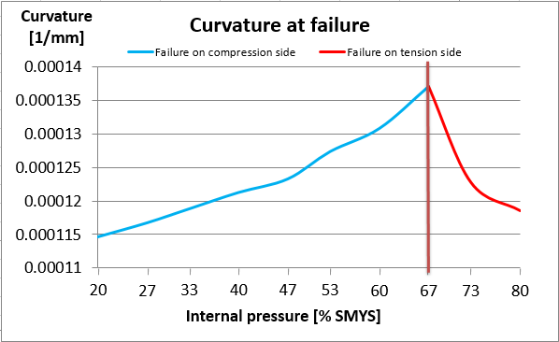
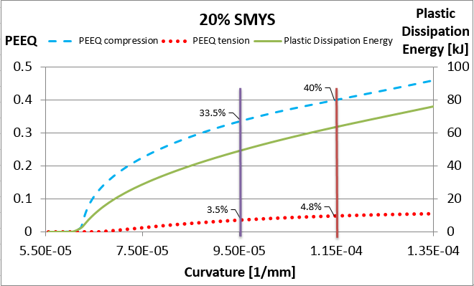
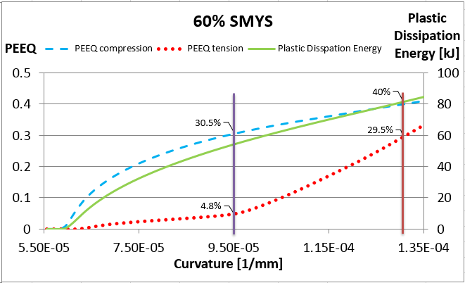
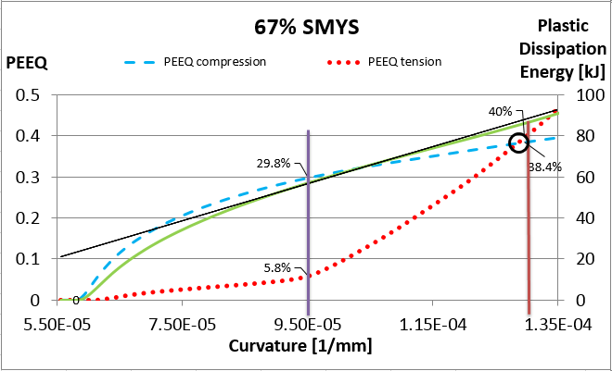
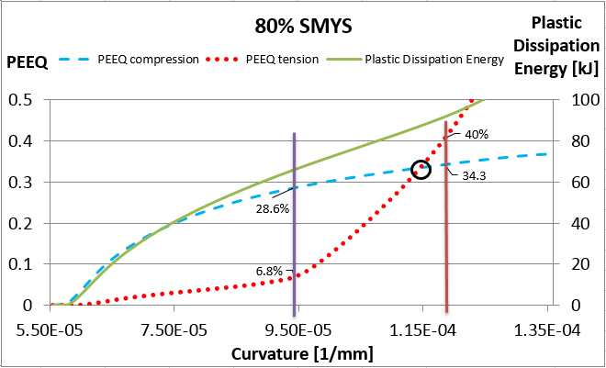
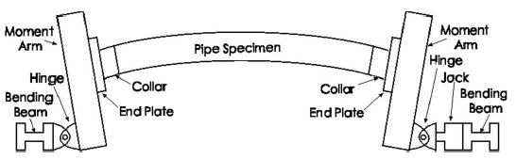
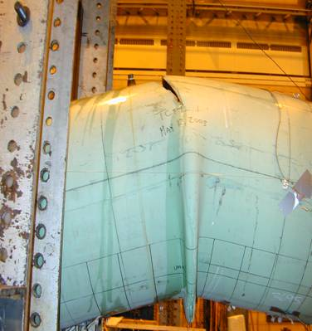
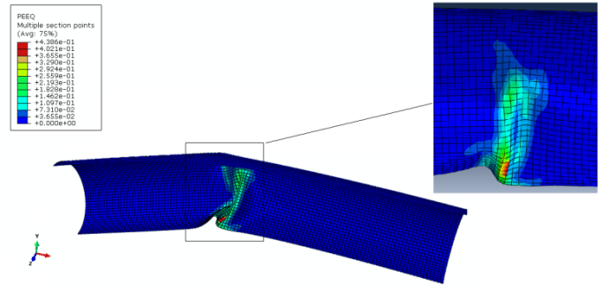
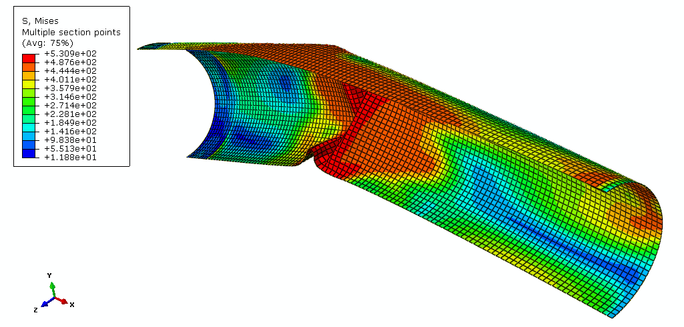
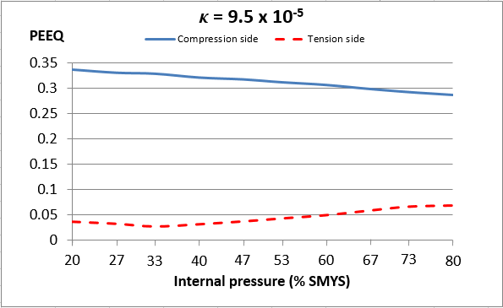
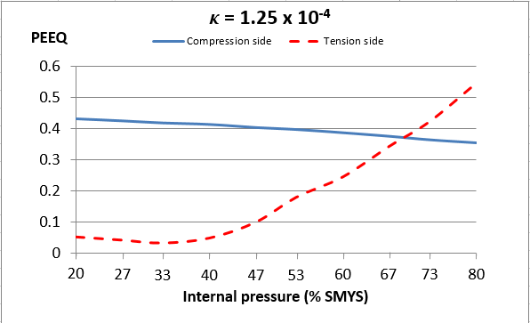
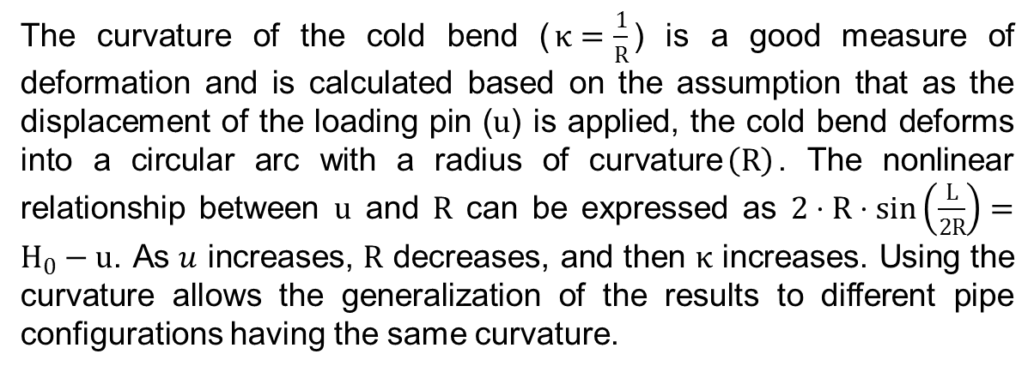
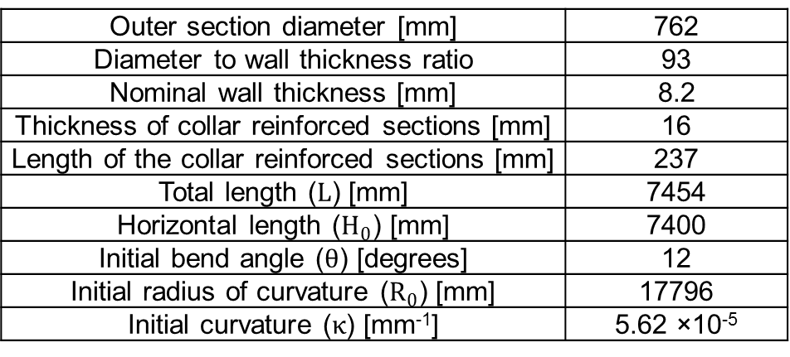
Numerical Analysis of Pressurized Cold Bend Pipes under Bending to Investigate
the Transition from Compression to Tension Sides Failures
C. Cakiroglu¹, S. Adeeb¹, J.J.R. Cheng¹, M. Sen²
¹University of Alberta, Department of Civil and Environmental Engineering, ²Enbridge Pipelines Inc
Edmonton, AB, Canada
INTRODUCTION :
METHODS :
The high pressurized (80% SMYS) cold bend pipe showed a material failure on the tension side after the formation of a compression side.
For internal pressure less than 67% SMYS, the equivalent plastic strain reaches failure criterion on the compression side, while for internal pressure more than 67% SMYS, the strain reaches failure criterion on the tension side.
Pipelines are threatened by unstable geotechnical movements due to slope instability, discontinuous permafrost and seismic activities , which may cause excessive external loading in the form of tensile and bending forces. In order to change the direction of a pipeline to conform to the terrain conditions, a cold bending procedure is often applied. The procedure not only changes pipe cross sectional geometry but also changes its material properties, such as an accumulation of residual stress at the cold bend locations. Because of the combination of residual stresses due to the cold bending procedure and the strains due to the external forces, it is crucial to investigate the structural response of cold bend pipes under external loading, which eventually leads to a material failure of fracture or buckling.
Sen et al (2006) carried out an extensive experimental study with cold bend pipes under in-plane bending and internal pressure. The failure mode of each experiment were either failure due to fracture at the compression side of the wrinkles or buckling and a magnification of the imperfection patterns without fracture, except one high pressure X65 pipe. This specimen under applied bending and an internal pressure corresponding to 80% SMYS hoop stress suddenly fractured on the tension side of the wrinkle in the post-buckling phase after the development of a wrinkle on the compression side. Based on this result, Cakiroglu et al (2012) further investigated the behavior of tension side fracture of high pressure cold bend pipe by numerical analysis. The four different levels of internal pressure corresponding to 70.6%, 73.8%, 76.9% and 80% SMYS hoop stresses were applied. Similar load – displacement response was observed for each level of internal pressure, and all of them failed on tension side fracture albeit at different time instants during the loading process.
FEA SIMULATIONS
The experimental setup of Sen were simulated using the finite element analysis software ABAQUS. The simulated material was of grade X65 with SMYS of 448MPa and an ultimate strength of 531MPa and all geometric properties are listed. For the sake of computational efficiency, only one quarter of the entire geometry was modelled by two symmetry planes y-z and x-y planes. 10 different levels of internal pressure were simulated with values ranging from 1.93 MPa (20% SMYS) to 7.7 MPa (80% SMYS). Also, a simulation without an internal pressure was included. After applying a value of internal pressure, a horizontal displacement (300 mm) was applied on the loading pin which increased the curvature (1.44×10⁻⁴ 1/mm) of the cold bend pipe. A failure criterion based on the maximum equivalent plastic strain reaching a critical value of 40% was utilized to assess the models behavior up to failure.
(a)
(b)
Figure 3: (a) Equivalent plastic strain distribution and (b) von Mises Stress under bending load with internal pressure of 80% SMYS
For all internal pressure levels, the development of the equivalent plastic strain on both tension and compression sides and the plastic dissipation energy are similar at the initial stages of loading up to a specified intermediate curvature (9.5×10⁻⁵ 1/mm). Beyond this curvature, the strain on the compression side reaches the 40% failure criterion for 20% and 60% cases; however, the strain on the tension side reaches the 40% failure criterion for 67% and 80% cases, because the strain increases with a much faster rate exceeding the strain on the compression side.
Figure 6: The relationship between the applied curvature in [1/mm] at failure (using the 40% equivalent plastic strain failure criterion) and the internal pressure.
Table 1: Geometric properties of the full scale specimen
LIMITATIONS:
Outer section diameter [mm] | 762
Diameter to wall thickness ratio | 93
Nominal wall thickness [mm] | 8.2
Thickness of collar reinforced sections [mm] | 16
Length of the collar reinforced sections [mm] | 237
Total length ($L$) [mm] | 7454
Horizontal length ($H_{0}$) [mm] | 7400
Initial bend angle ($θ$) [degrees] | 12
Initial radius of curvature ($R_{0}$) [mm] | 17796
Initial curvature ($κ$) [mm⁻¹] | 5.62 ×10⁻⁵
The assumption of a perfectly circular cold bend axis in the calculation of the curvature is valid at the initial stage of the analysis until the formation of a wrinkle at which point. It would be better to use a different deformation measure.
The designated failure criterion when the maximum equivalent plastic strain reaches 40% in a single element in the discretized geometry is conservative. It would be better to use a more general approach to define the failure criterion based on the average equivalent plastic strain value in a predefined geometric domain.
The development of the equivalent plastic strain with respect to increasing internal pressure is studied for a designated geometric and material configuration. The transition of the failure mode from compression side to tension side could occur at different levels of internal pressure for different pipe configurations.
DEFORMATION MEASURE
The curvature of the cold bend ($κ=\frac{1}{R}$) is a good measure of deformation and is calculated based on the assumption that as the displacement of the loading pin ($u$) is applied, the cold bend deforms into a circular arc with a radius of curvature$\left(R\right)$. The nonlinear relationship between $u$ and $R$ can be expressed as $2⋅R⋅sin\left(\frac{L}{2R}\right)=H_{0}−u$. As $u$ increases, $R$ decreases, and then $κ$ increases. Using the curvature allows the generalization of the results to different pipe configurations having the same curvature.
y
x
(a)
(b)
Figure 4: Development of the equivalent plastic strain on the compression side, on the tension side and the plastic dissipation energy as curvature increases for internal pressure levels of 20%, 60%, 67% and 80%SMYS
CONCLUSIONS:
Figure 1: (a) Schematic of Sen’s experimental setup; (b) Compression side wrinkle and tension side fracture of Sen’s specimen
RESULTS:
The structural response of a cold bend configuration is investigated numerically in case of changing the curvature of the cold bend. A parametric study is carried out to analyze the significant effect of internal pressure. For such specified cold bend pipe simulation, an internal pressure value of 67% SMYS is determined as a transition point of the material failure mode from compression to tension side.
In this current work, the full scale test configuration of a cold bend pipe resulting in the tension side fracture is investigated numerically. In all simulations a combination of internal pressure and displacement which increases the curvature of the cold bend is applied. Particularly, a parametric study is carried out to analyze the effect of internal pressure, with values ranging from 20% SMYS to 80% SMYS.
As the internal pressure increases, the maximum equivalent plastic strain decreases on the compression side and increases on the tension side for any value of applied curvature. At a lower curvature (9.5×10⁻⁵ 1/mm), these strain changes are relatively small; however, at a higher curvature (1.25×10⁻⁴ 1/mm), there is a dramatic increase in the strain on the tension side.
The unpressurized cold bend pipe developed a diamond shaped wrinkle at the compression side in the post-buckling phase.
REFERENCES:
OBJECTIVE:
[1] Sen M. (2006); “Behaviour of Cold Bend Pipes Under Combined Loads” Ph.D. dissertation, University of Alberta, 2006
[2] Caminada S, Cumino G, Cipolla L, Di Gianfrancesco, A (2009). “Cold bending of advanced ferritic steels: ASTM grades T23, T91, T92”. International Journal of Pressure Vessels and Piping 86 (2009) 853–861
[3] Sen M., Cheng, J.J.R. , Zhou, J. (2011). “ Behaviour of Cold Bend Pipes under Bending Loads”
DOI: 10.1061/(ASCE)ST.1943-541X.0000219. 2011 American Society of Civil Engineers
[4] Cakiroglu C, Komeili A, Adeeb S, Cheng JJR, Sen M (2012). “Numerical Analysis of High Pressure Cold Bend Pipe to Investigate the Behaviour of Tension Side Fracture”, IPC2012-90381
[5] Sen M, Cheng JJR, Murray DW (2004). “Full-Scale Tests of Cold Bend Pipes” Proceedings of IPC2004, International Pipeline Conference, IPC2004 – 743
[6] Miki C, Kobayashi T, Oguchi N, Uchida T, Suganuma A, Katoh A. (2000). “Deformation and fracture properties of steel pipe bend with internal pressure subjected to in-plane bending ”. Proceedings of the 12th World Conference on Earthquake Engineering.
[7] Pressley A (2010). “Elementary Differential Geometry”. ISBN: 978-1-84882-891-9
To further investigate the level of internal pressure which contributes to the tensile fracture of cold bend pipes and determine a transition point of the mode of failure from compression side to tension side.
(a)
(b)
Figure 2: (a) Equivalent plastic strain distribution and (b) von Mises Stress under bending load without internal pressure
Figure 5: Variation of the equivalent plastic strain with respect to internal pressure at the compression and tension sides for two curvature values

